Slide 1

Real-Time Facial Emotion Detection
Jay Choksi
Prathamesh Tari
Dhruv Patel

Slide 2
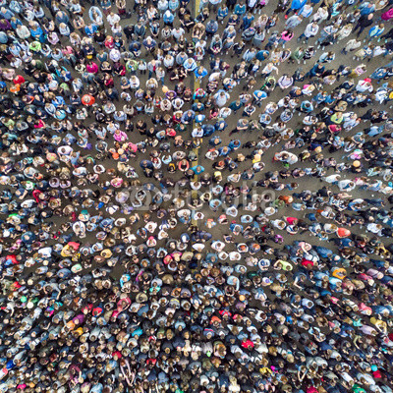
Data
FER2013 dataset
Large, publicly available Face Expression Recognition(FER) dataset
Consisting of 35,887 face crops
The dataset is in terms of person age, face pose, and other factors
Reflecting realistic conditions.

Slide 3
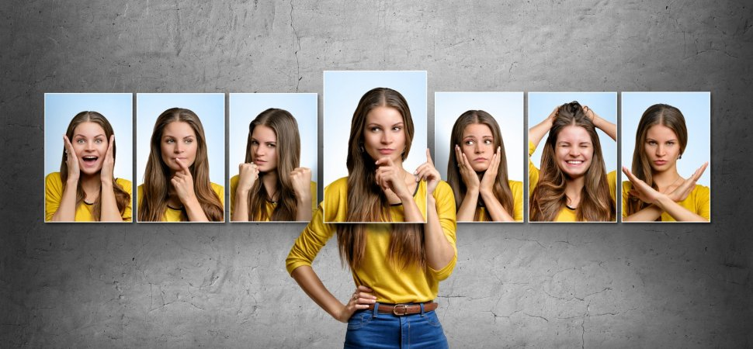
Objective
The objective is to categorize the emotions into the following categories:
Angry
Disgust
Fear
Happy
Sad
Surprise
Neutral

Slide 4
Project summary
Recognizing emotions under controlled conditions ---> Simpler.
In naturalistic conditions like different poses, illumination, etc.---> Challenging
Built a CNN model ---> To identify Expressions
Live streaming ---> Identifying Facial emotions live through a web-camera

Slide 5
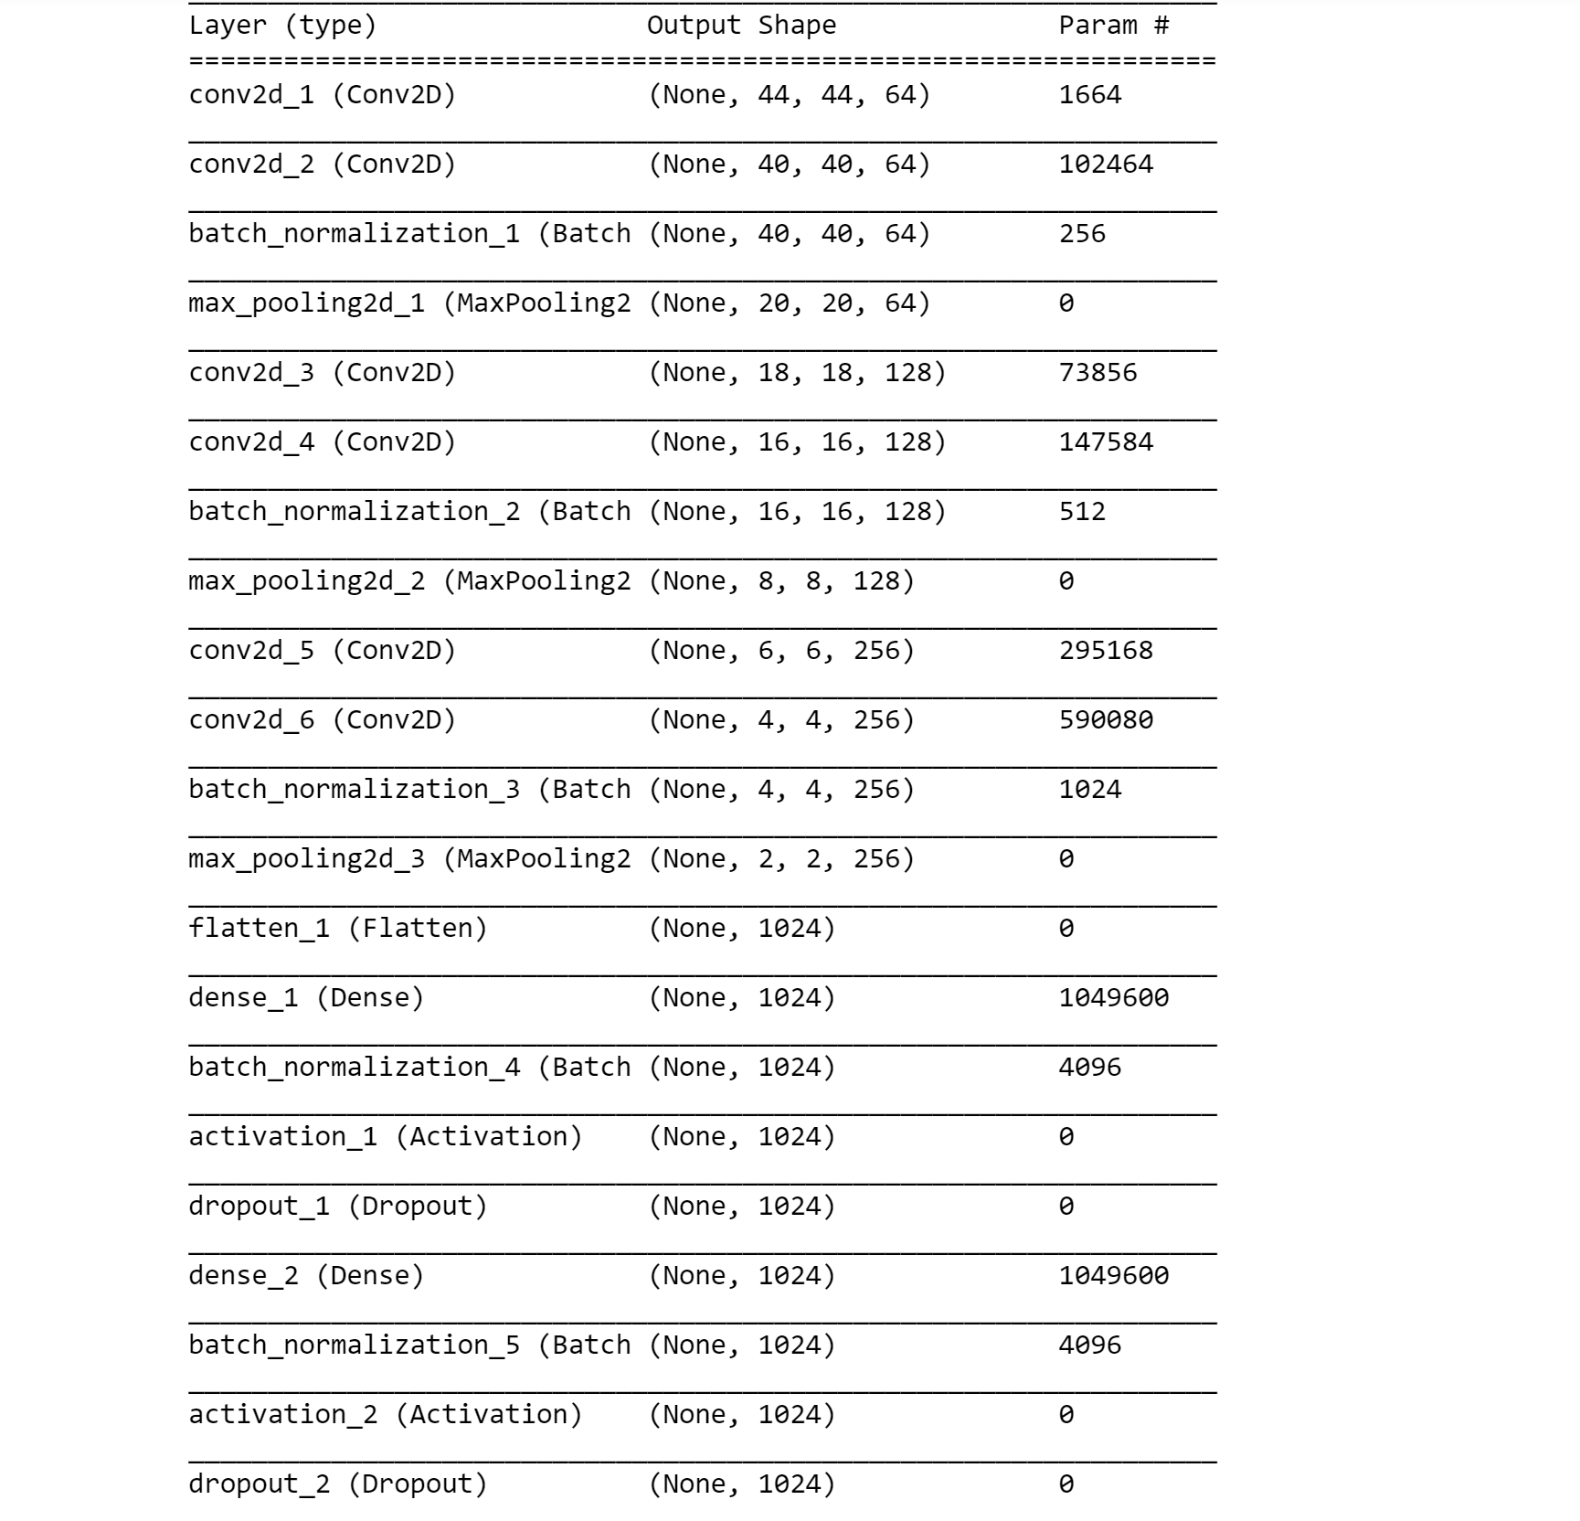
Our model:

Slide 6
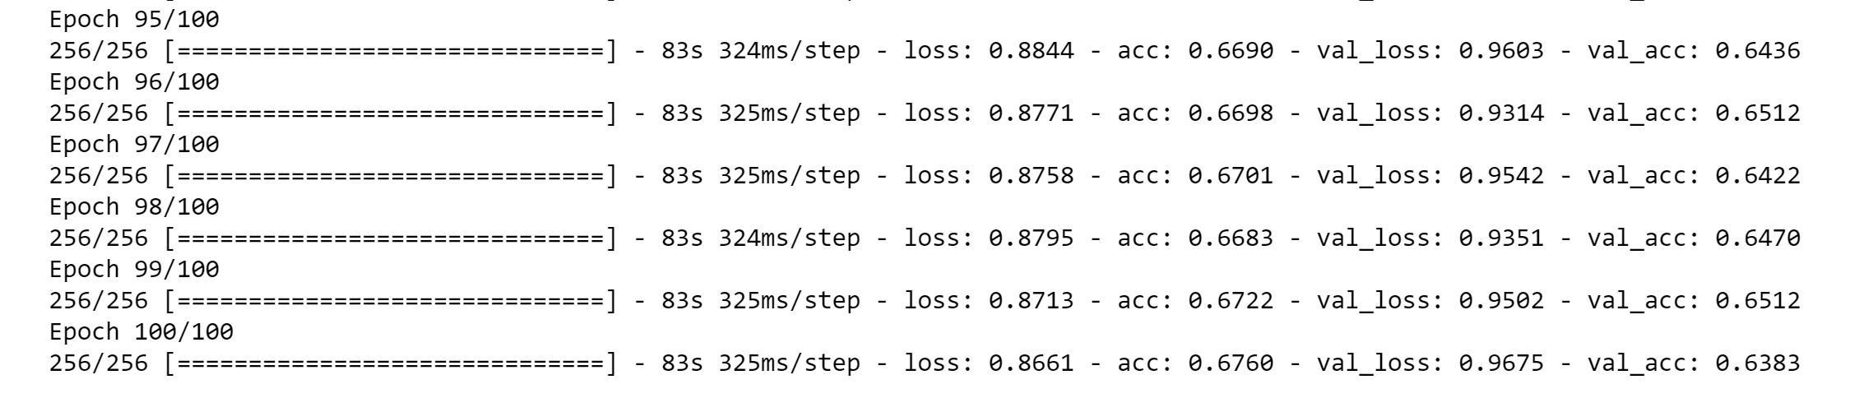
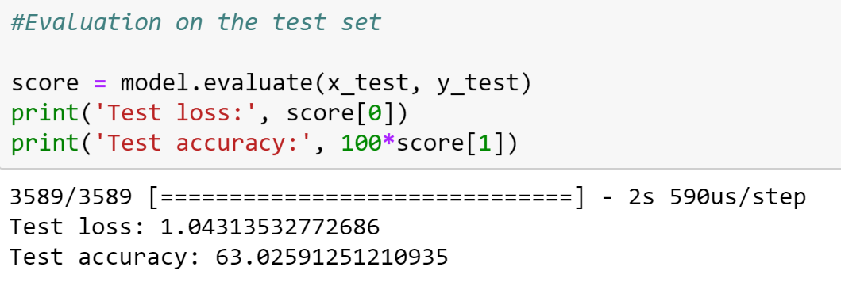
Train, validation and test accuracy:

Slide 7
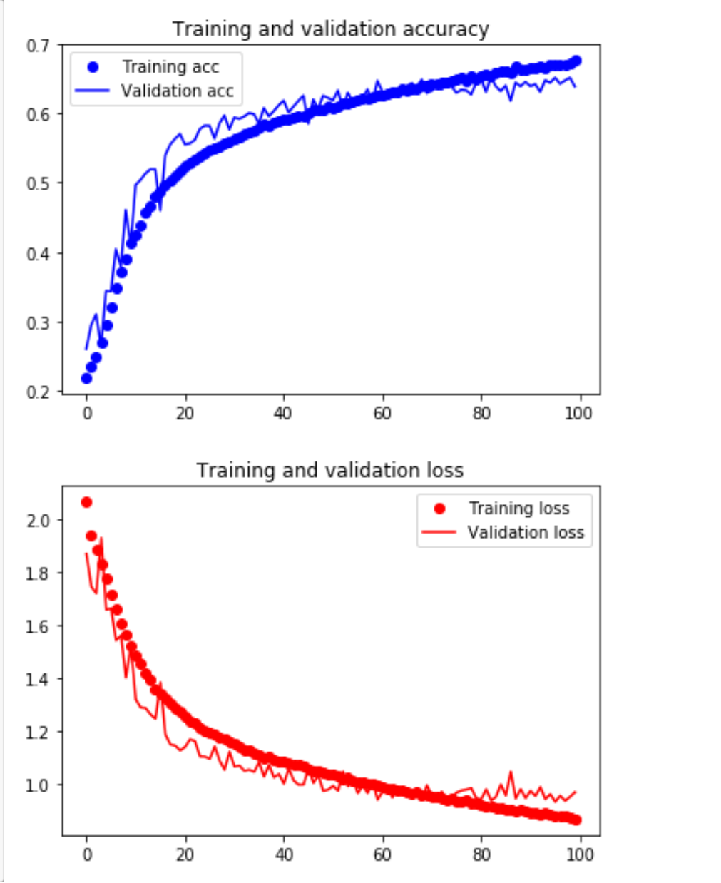
Graphs:

Slide 8

Visualizing the Convolutional network
Let’s consider the following image to see how the convolutional network works

Slide 9
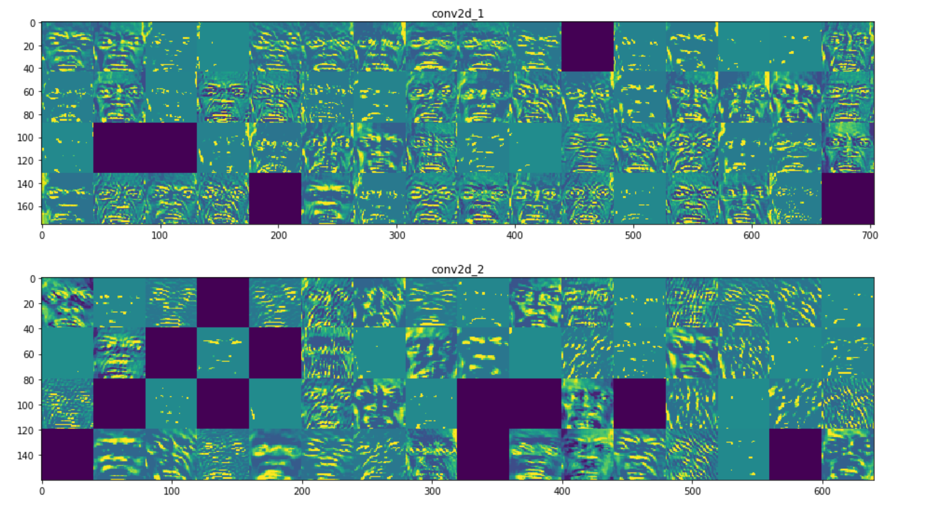
First 2 layers:

Slide 10
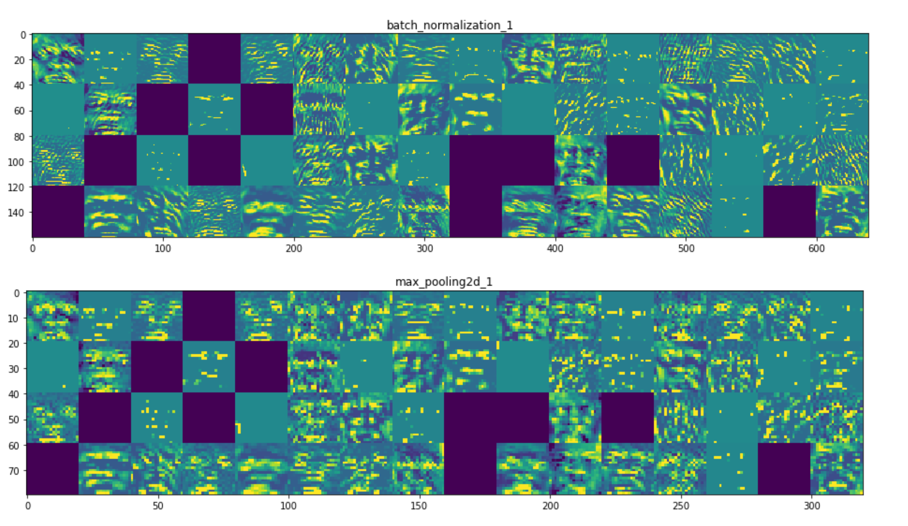
Next 2 layers:

Slide 11
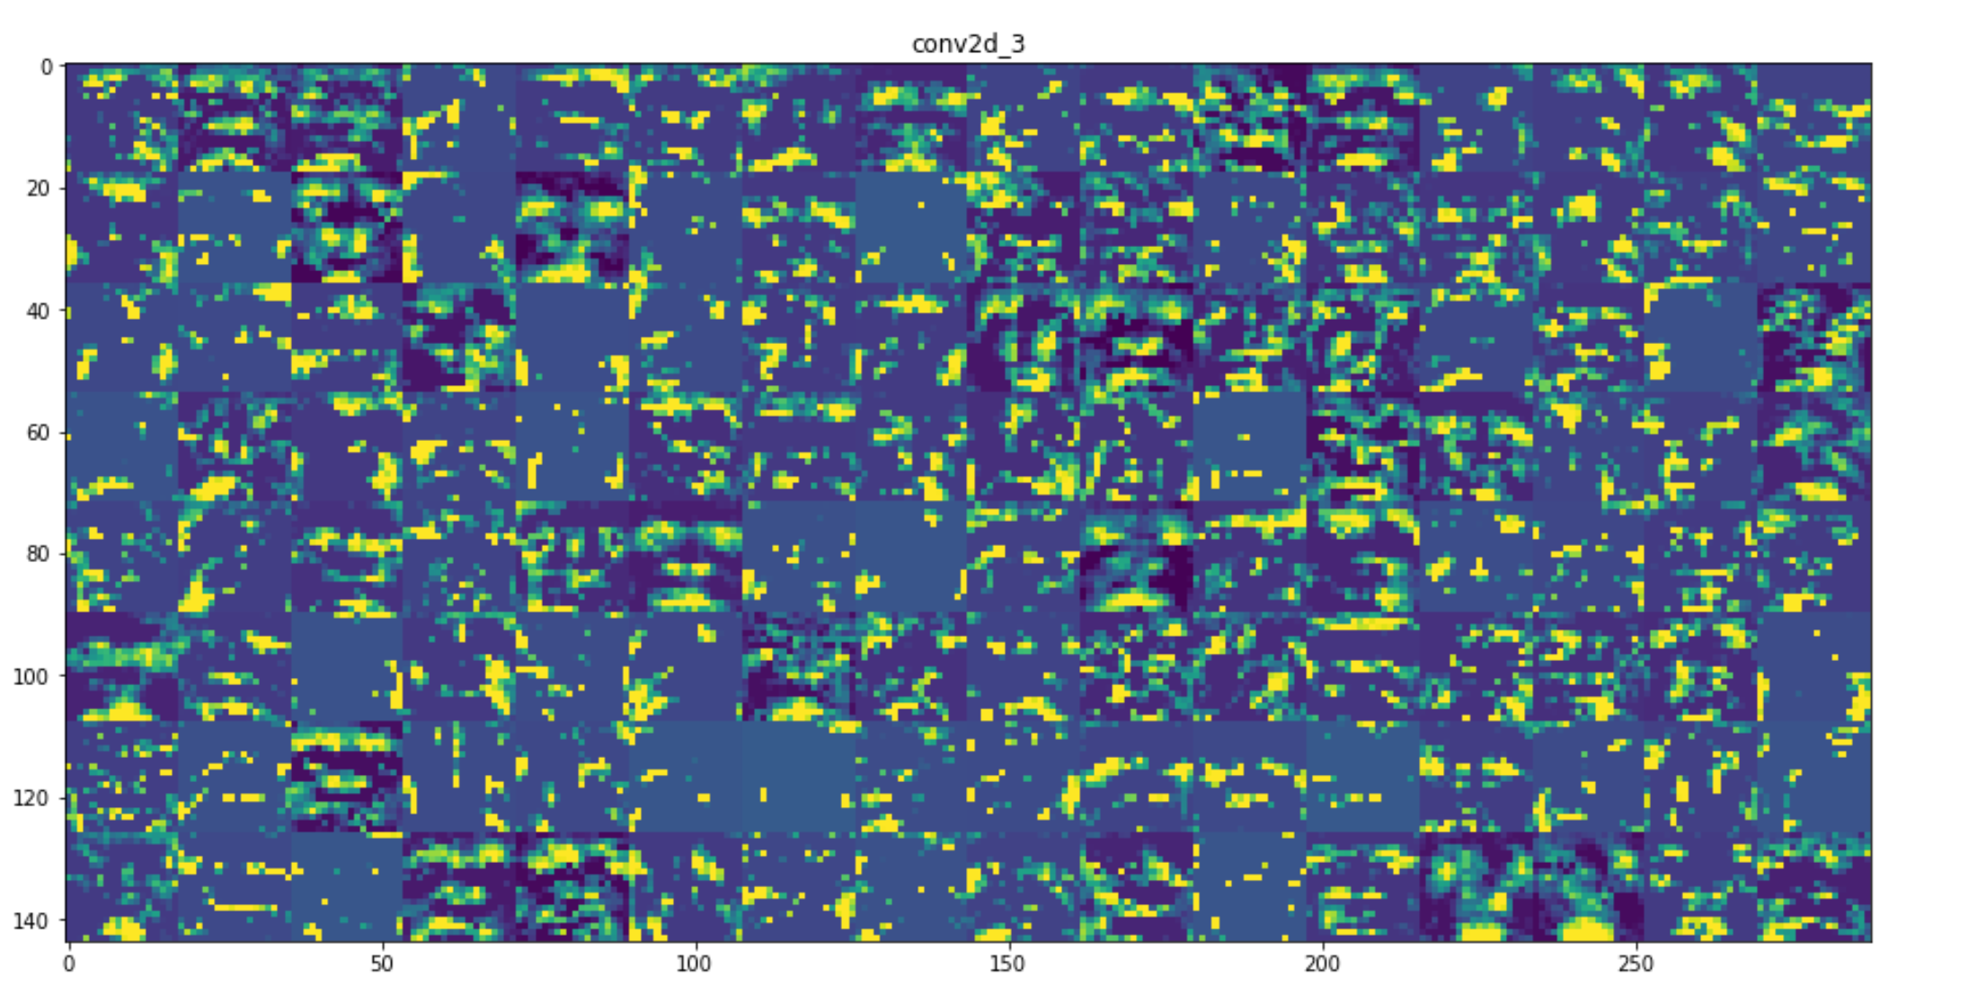
5th layer:

Slide 12
Similarly..
The 1st layer acts as a collection of various edge detectors. At that stage, the activations are still retaining almost all of the info present in the initial picture.
As we go higher-up, the activations become increasingly abstract and less visually interpretable.
Higher-up presentations carry increasingly less info about the visual contents of the image, and increasingly more info related to the class of the image.

Slide 13
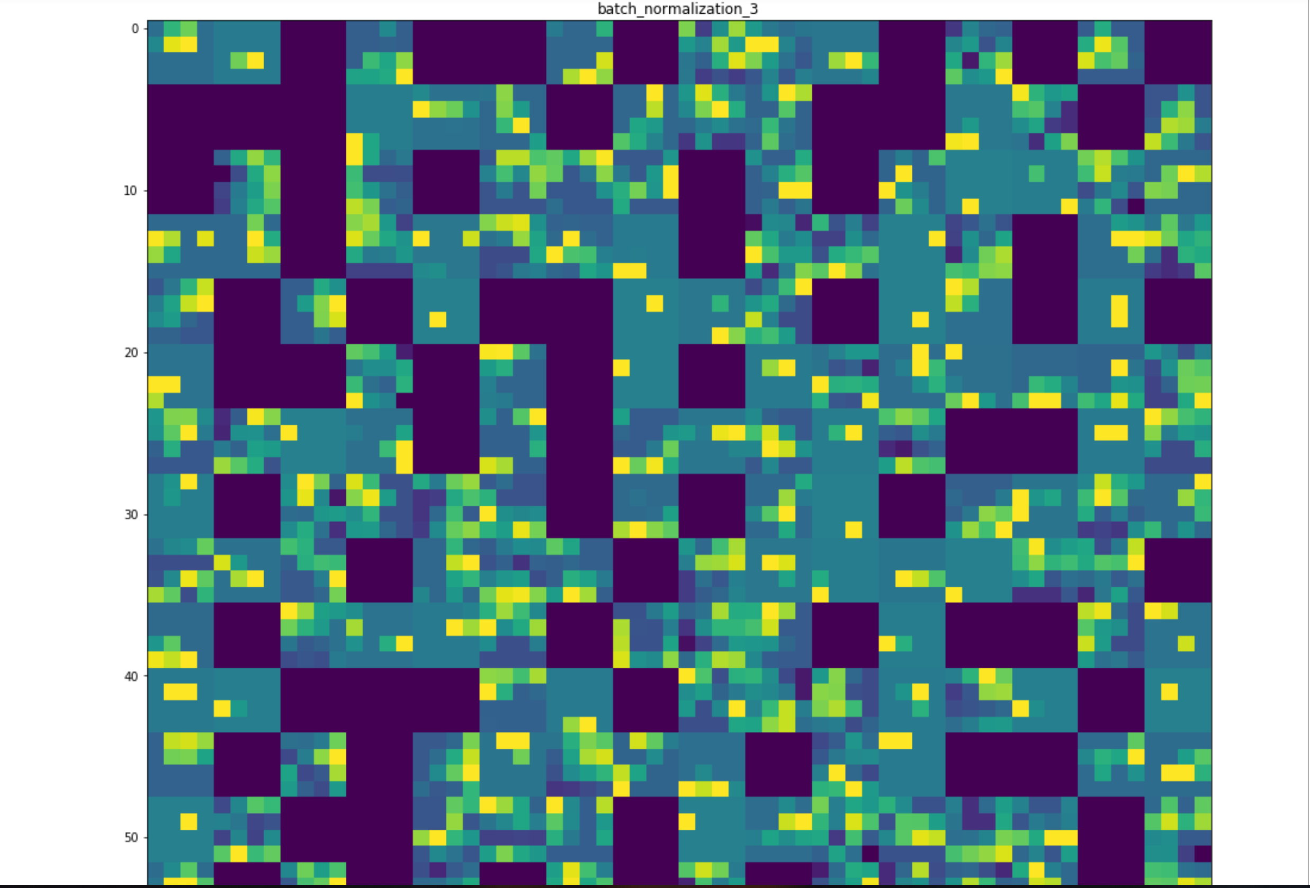
11th layer

Slide 14
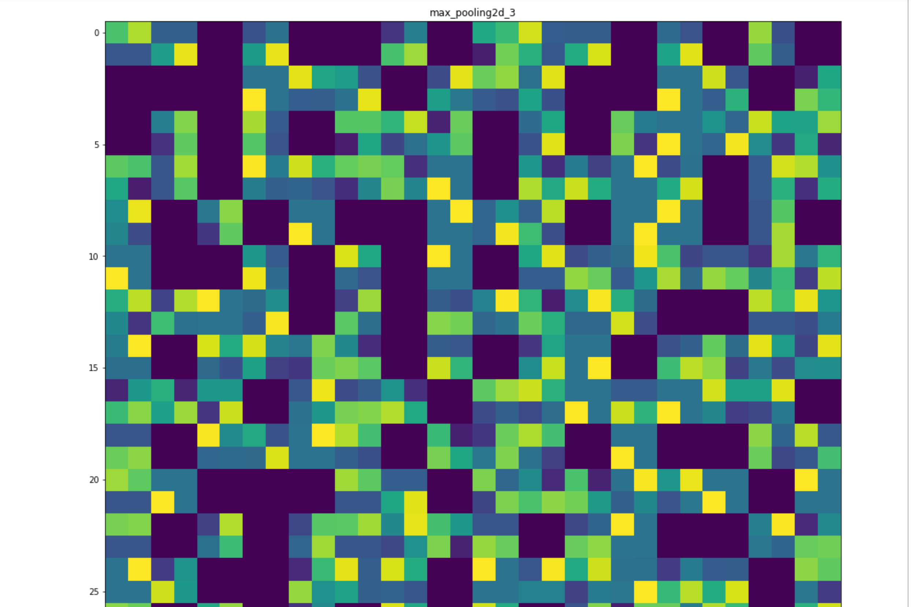
12th layer

Slide 15

Live streaming using a webcam..

Slide 16
Aim for the coming days..
Work on improving the accuracy of the test data
Try to display the percentage accuracy of the emotion being detected
Try and implement the detection of gender of the person along with the already existing facial emotion detection in our project

Slide 17
Thank you!
This concludes our presentation.

